Slide 1
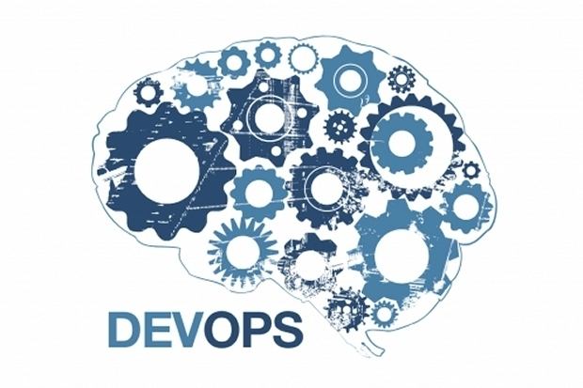
DevOps & Cloud Infrastructure SEIS 665 Week 12
Jason Baker
Adjunct Instructor
Graduate Programs in Software
University of St. Thomas
St. Paul, MN

Slide 2
Agenda
DevOps 101
Basic Lean theory
Design For Operations
Infrastructure as code
Continuous Integration
DevOps Pipeline

Slide 3
DevOps Defined
DevOps is a culture, movement or practice that emphasizes the collaboration and communication of both software developers and other IT professionals while automating the process of software delivery and infrastructure changes.
-- Wikipedia

Slide 4
Is DevOps really new?
Operations staff have been automating system configurations for decades
Shell scripts
PXE boots
VMWare templates
Developers have also been automating software releases
Make, Ant, CVS…
Despite these efforts, we still have problems...

Slide 5
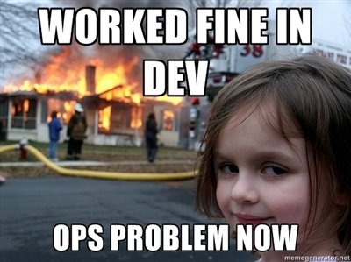

Slide 6
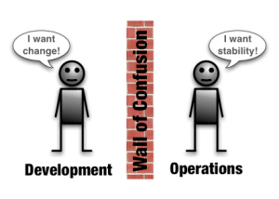

Slide 7

Conflicting measures of success
Development success is measured by number of new features added to a release.
Operations success is measured by how long the service stays up.

Slide 8
IT Change Management
Traditionally, in IT we manage the risk of change by:
Changing as infrequently as possible
Investing significant time planning for change
Changing at inconvenient times when staff and vendors are at their lowest performance levels
Batching changes during a change window

Slide 9

The Slippery Slope of Change Management
Change is risky.
Because of this risk, we don’t change things often.
But the longer we wait to make changes, the more things we have to change.
The more things we have to change, the greater the risk.

Slide 10

What’s DevOps
DevOps addresses traditional IT challenges, but what is it?

Slide 11
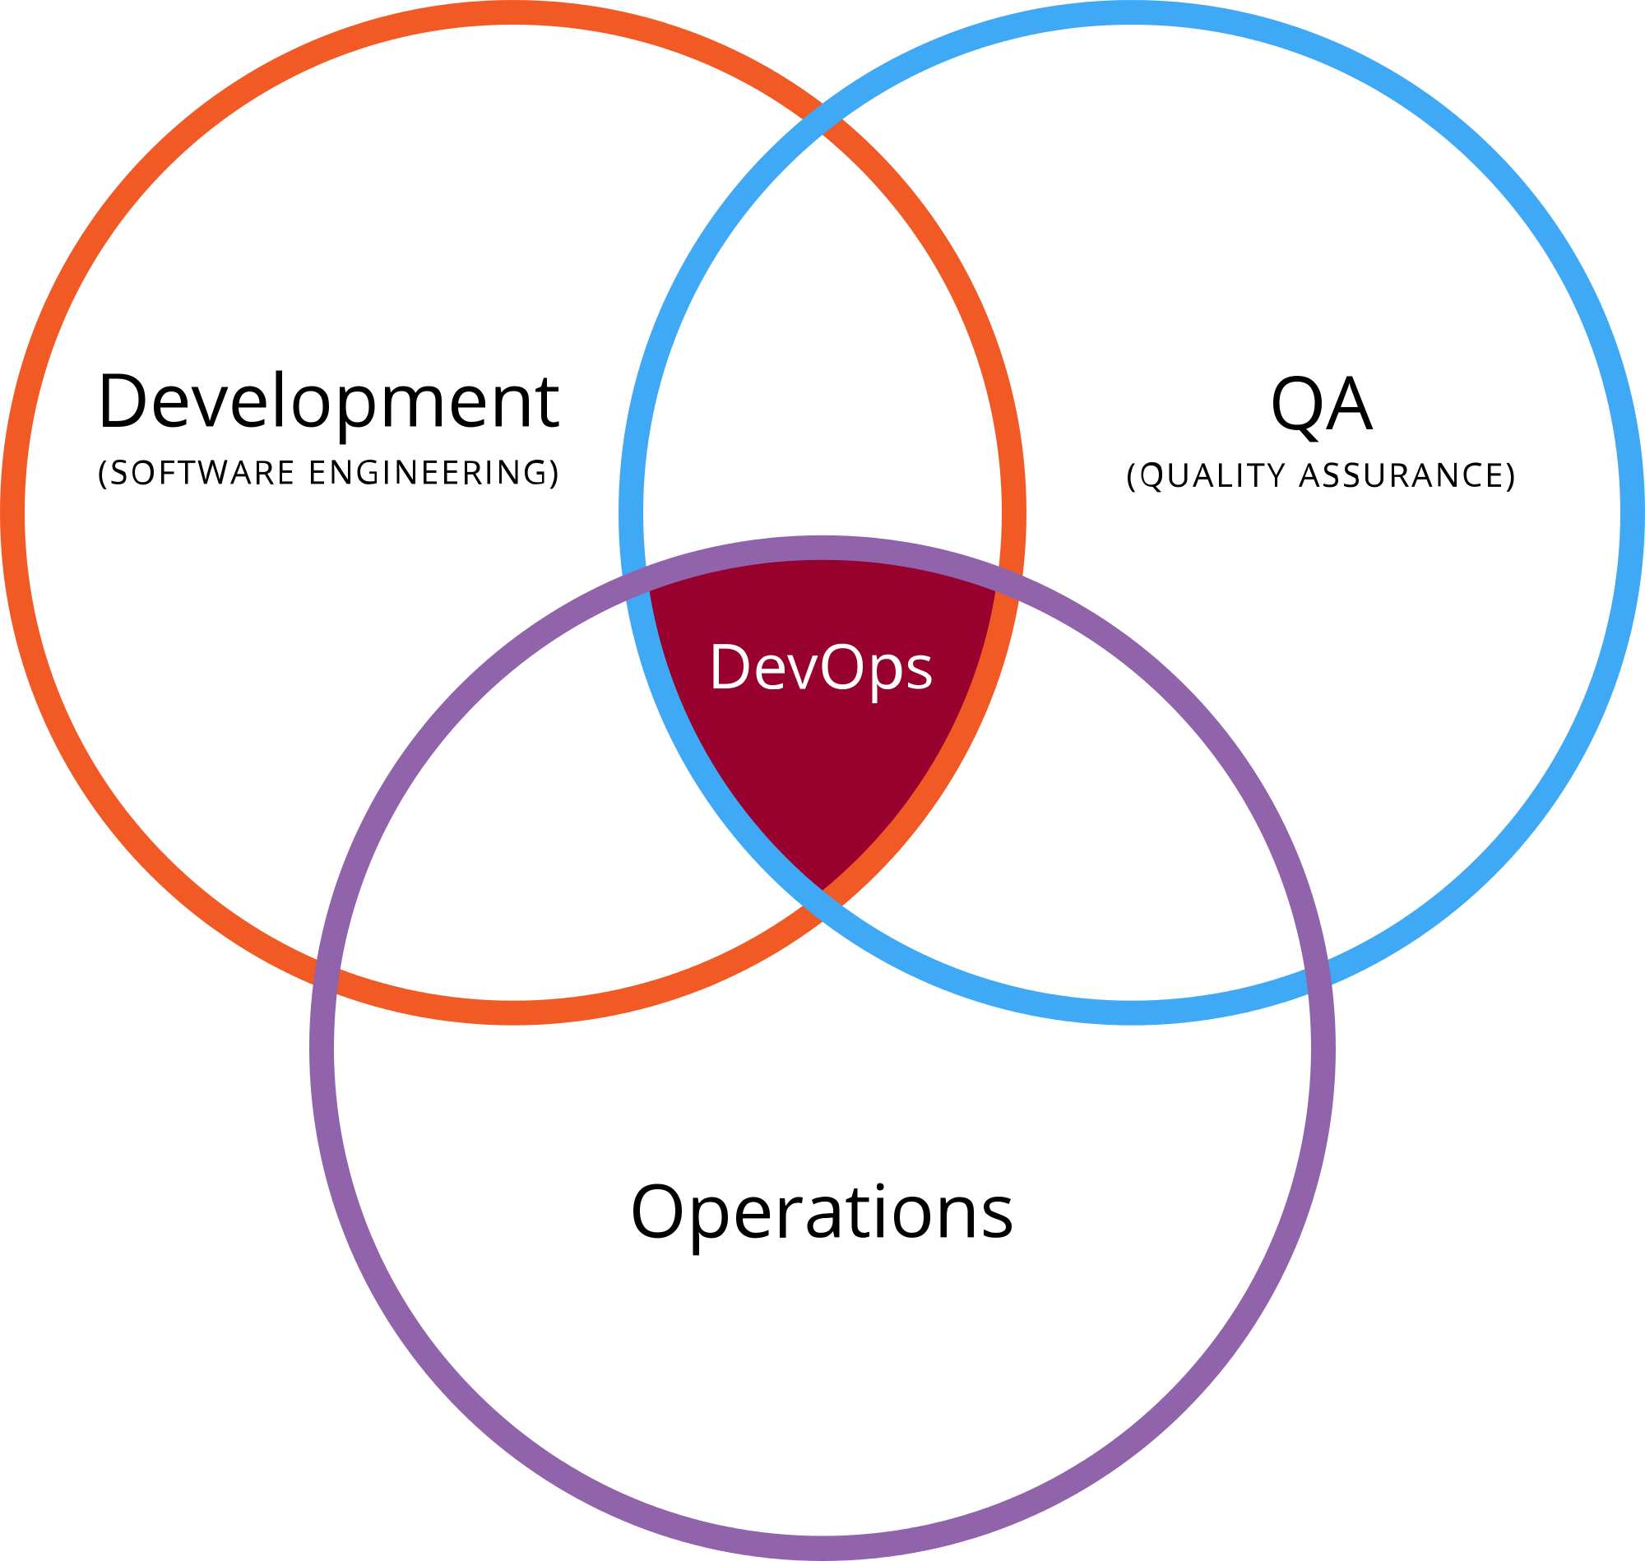
What is DevOps?
A set of practices exercised by multiple disciplines within the IT organization.

Slide 12
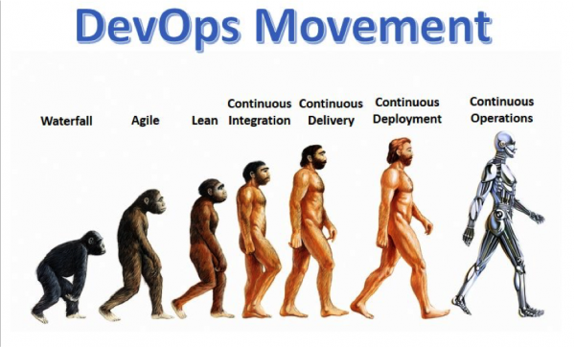
What is DevOps?
A cultural shift representing the natural evolution of the IT organization.

Slide 13
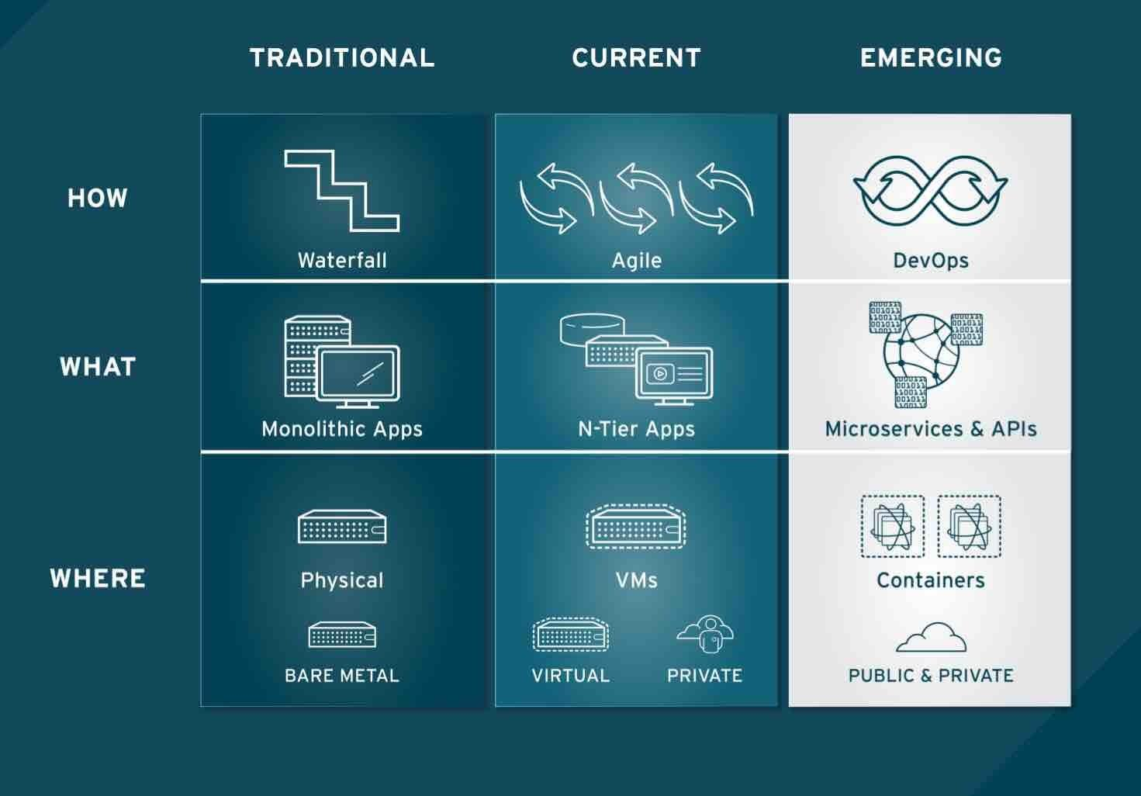
What is DevOps?
A technology shift.

Slide 14
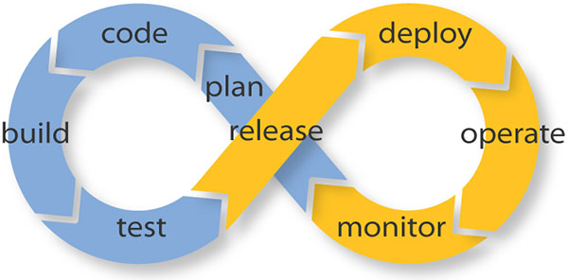
What is DevOps?
A collaborative effort to improve the service lifecycle.

Slide 15
Why does DevOps matter?
2016 State of DevOps Report
https://puppet.com/resources/white-paper/2016-state-of-devops-report
Survey of over 25,000 technology professionals over 5 years
Categorized IT organizations as High, Medium or Low performers
High = Multiple code deployments per day and lead times for changes less than one hour
Low = A code deployment every 1-to-6 months and at least a month lead times for changes.

Slide 16
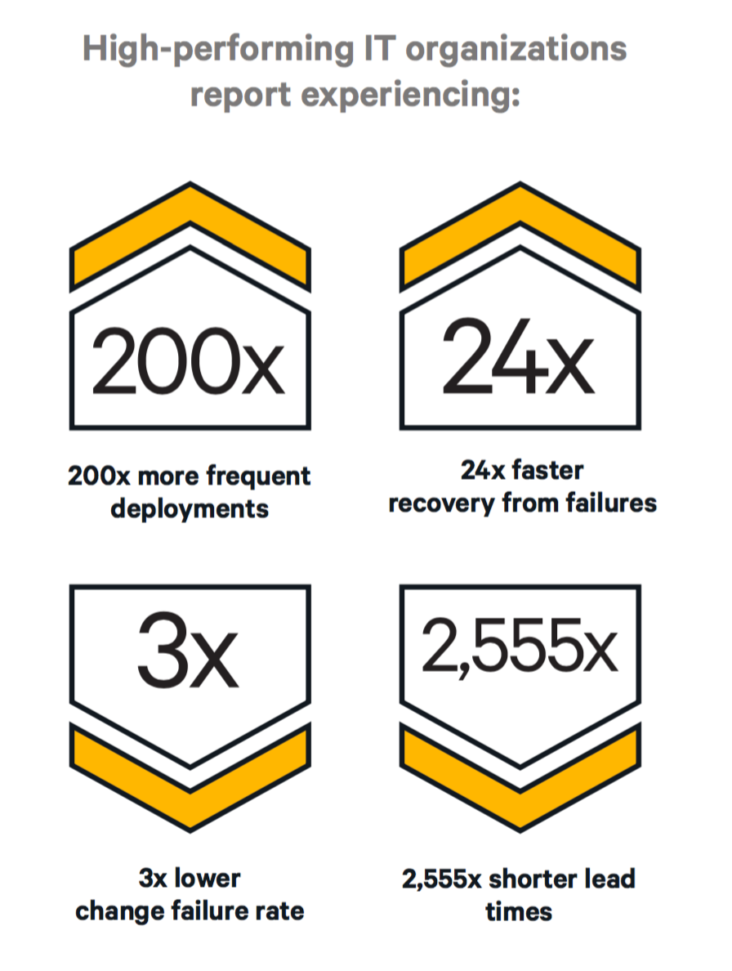
Source: 2016 State of DevOps Report

Slide 17
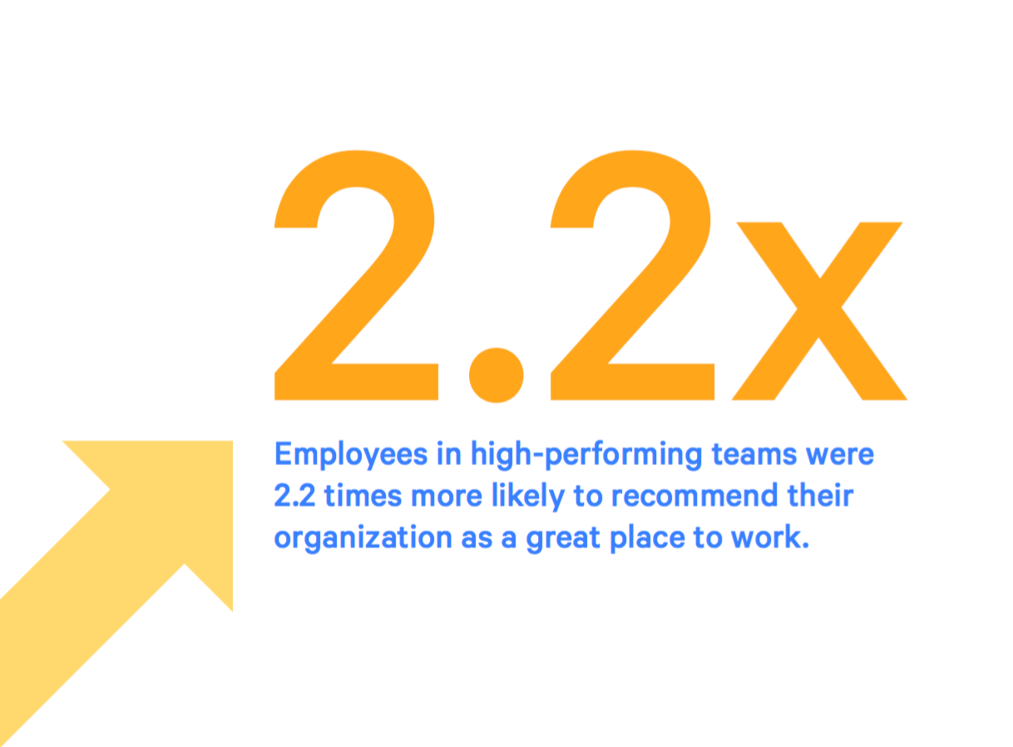
Source: 2016 State of DevOps Report

Slide 18

3 pillars of DevOps
Culture
Automation
Measurement

Slide 19
Common DevOps Misconceptions
You have to hire DevOps people to implement DevOps processes.
No, everyone participates.
DevOps is just automation.
Untrue, like saying Agile is just iterations.
Buying DevOps tools makes you a DevOps shop.
Tooling is the easy part. Everything else is hard.

Slide 20

DevOps Culture

Slide 21
Cultural priorities
Collaborative
Teams are multi-disciplined and focused on service delivery (the greater good)
Transparent
People share information with one another
Blame-less environment
Change oriented
Change is expected and embraced.
Developing a DevOps culture is the hard part!

Slide 22
Cultural priorities
Collaborative
Teams are multi-disciplined and focused on service delivery (the greater good)
Transparent
People share information with one another
Blame-less environment
Change oriented
Change is expected and embraced.
Developing a DevOps culture is the hard part!

Slide 23
Does my organization have a DevOps culture?
Do our developers and operations people sit near one another and go to lunch together?
Do they report up to the same person?
Do operations people attend developer planning meetings and vice-versa?
Do developers ever write automation scripts and operations people work on improving testing?

Slide 24

An Aside: DevOps Culture & Lean
DevOps culture is heavily influenced by Lean practices
Lean is a very common methodology in manufacturing
Commonly implemented as Six Sigma practices
Goals:
Eliminate waste
Improve product quality
Respect for people
Continuous improvement

Slide 25
Lean Queuing Theory
Theory applied to product and software development by Don Reinertsen
Lean is focused on value throughput using short cycle times versus keeping people busy.
Development is a stochastic system (non-linear and non-deterministic) with queues
Behavior of this type of system defies our instincts
Large batch sizes increase cycle time
Take longer to process leading to variability and more queues
Increasing worker utilization makes it worse!
Little’s Law: Maximize throughput by minimizing Work In Progress (WIP) using small batch sizes.
Source: https://less.works/less/principles/queueing_theory.html

Slide 26

Build a service, not software.

Slide 27
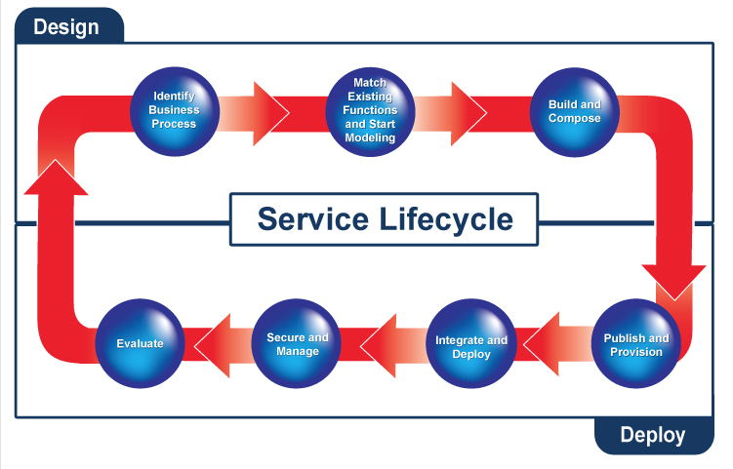
Developer-land
Operations-land

Slide 28
DevOps Team Focus
Developers more focused on earlier phases of lifecycle.
Operations more focused on later phases of lifecycle.
Both are accountable for service delivery and customer satisfaction.
Identify requirements
Modeling
Build & Compose
Publish & Provision
Integrate & Deploy
Secure & Manage
Operations
Participation Rate
Developers

Slide 29
Design For Operations
Problem: Software designs oftentimes don’t account for deployment, management, and support phases
Non-functional requirements:
How will we scale this feature?
How will we provide high availability?
How will our customer service team support this?
In a DevOps culture, operations staff participate in software planning meetings.
Operations ensures non-functional requirements are part of the software design
Availability, Scalability, Upgradeability, Supportability, Testability, etc

Slide 30
Developer Operational Support
Developers participate in service delivery and support
Builds accountability: “Eat your own dog food”.
Developers are part of the on-call support team.
If Developers provide service delivery support, do they get root?
Not necessarily, but they should have enough access to troubleshoot common issues.
Full access to all infrastructure and application logs
Full access to metrics
Ability to remediate issues by pushing out corrective updates

Slide 31
Transparency
In DevOps organizations, staff are empowered to improve quality.
Lean principle: anyone can stop the production line at any time.
Everyone works together to solve the quality problem.
Management accepts the blame, not the worker.
Service issues are addressed at postmortem meetings
Scheduled no later than 48 hours after incidents
Focus on determining root cause, not assigning blame
Corrective action given the highest priority

Slide 32
Transparency
A transparent, blameless environment is a safer environment for employees.
More willing to participate in discussions and raise awareness of potential problems.
Employees won’t hide mistakes.
More willing to experiment and test ways to improve the service.
Survey statistics show that employees are happier in this environment.

Slide 33
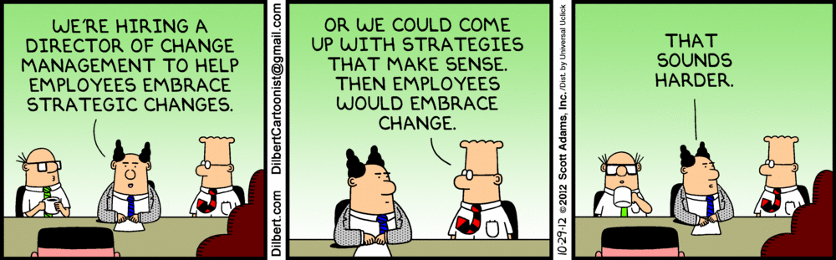

Slide 34
Embrace Change
DevOps cultures recognize that change is inevitable, so they embrace it.
Lean: Smaller batch sizes -> increasing rate of change
The more we change, the better we get at it.
Sports teams can’t get together every 3 months and expect to win a championship. They have to practice.
Learn to change often
Monthly -> Weekly -> Daily -> Hourly
Should be able to push most changes at any time of day without impacting services

Slide 35
Embrace Change
But some changes can’t happen in the middle of the day like database schema changes, right?
Most database changes do not require a service maintenance window if designed and sequenced carefully.
Change process may require multiple software updates to transform the schema from one version to another.
This process is hard for traditional organizations because their lead time is too long.
It’s easier to just disrupt the service and push in the change.

Slide 36

Automation

Slide 37
Automation
DevOps mantra: Automate (almost) everything.
Humans are brittle
Best way to reduce cycle time and improve quality
Most cost effective way to scale work

Slide 38
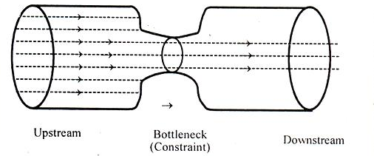
Theory of Constraints
What do we automate first?
Theory of Constraints (Eliyahu Goldratt):
Think of your process as a chain of links
Improving strong links doesn’t strengthen the chain
Improve the weakest link first

Slide 39
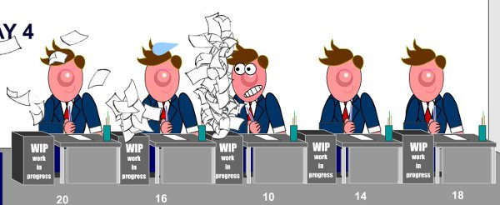
Theory of Constraints
Example: If it requires 40 hours of effort to test a release and 10 minutes to deploy it, then the testing process is a constraint on improving cycle time.

Slide 40
Infrastructure as Code

Slide 41
Software Assembly Line
DevOps treats software development and running a service like a manufacturing assembly line.
Design the product
Assemble it
Test it
Package it for deployment
Work moves through the company, queuing up at various stations.
For example: product backlog and QA tests are very visible sorts of queues

Slide 42
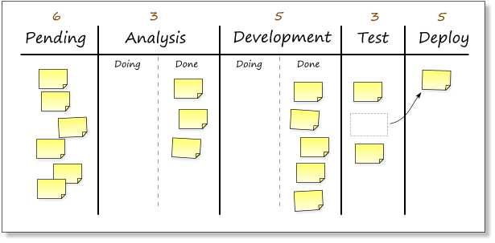
Software Assembly Line
Example: Kanban board showing queues

Slide 43
Software Assembly Line
Again, DevOps adopts lessons from Lean
W. Edwards Deming: “Cease dependence on inspection to achieve quality. Build quality into the product.”
Oftentimes companies build software and then invest significant effort testing (inspecting) it later.
Exploratory testing
End-to-end testing
User Acceptance testing

Slide 44
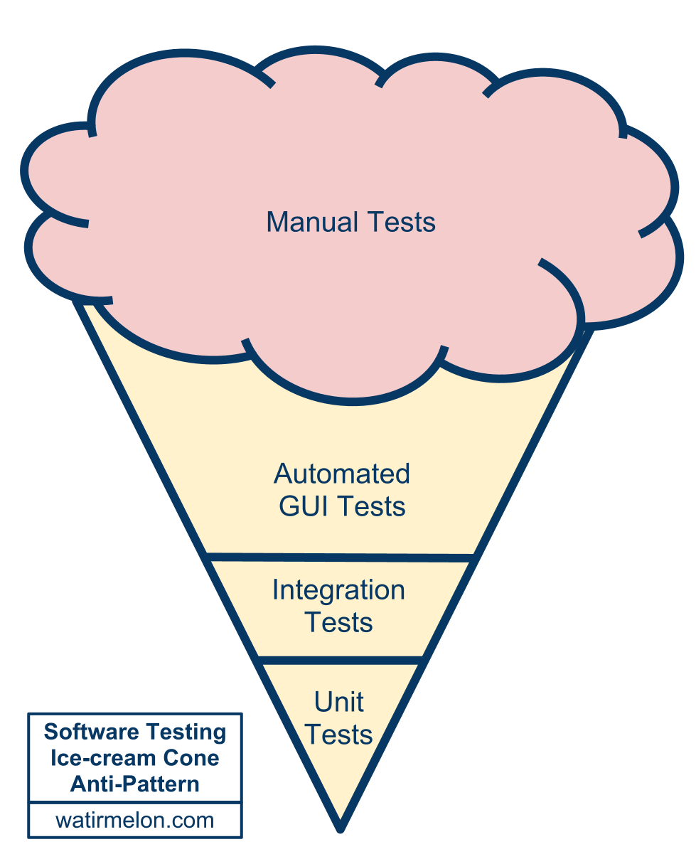
Testing Anti-Pattern

Slide 45
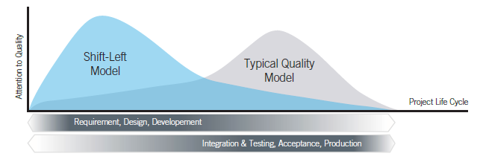

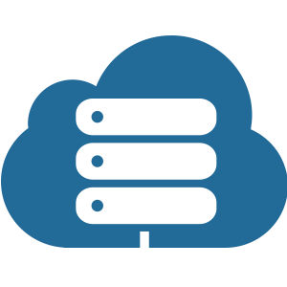
Shift Left
DevOps adopts a “Shift Left” Lean alignment in order to resolve quality issues earlier in the process.

Slide 46
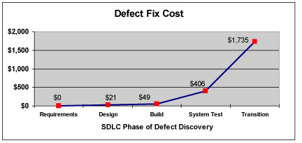
Shift Left
Why does shifting left improve quality and reduce costs in software development?
Defects are discovered earlier.
It’s easier to automate testing (bake quality into the product).
It’s much easier for a developer to fix a defect found during unit testing than in deployment.

Slide 47
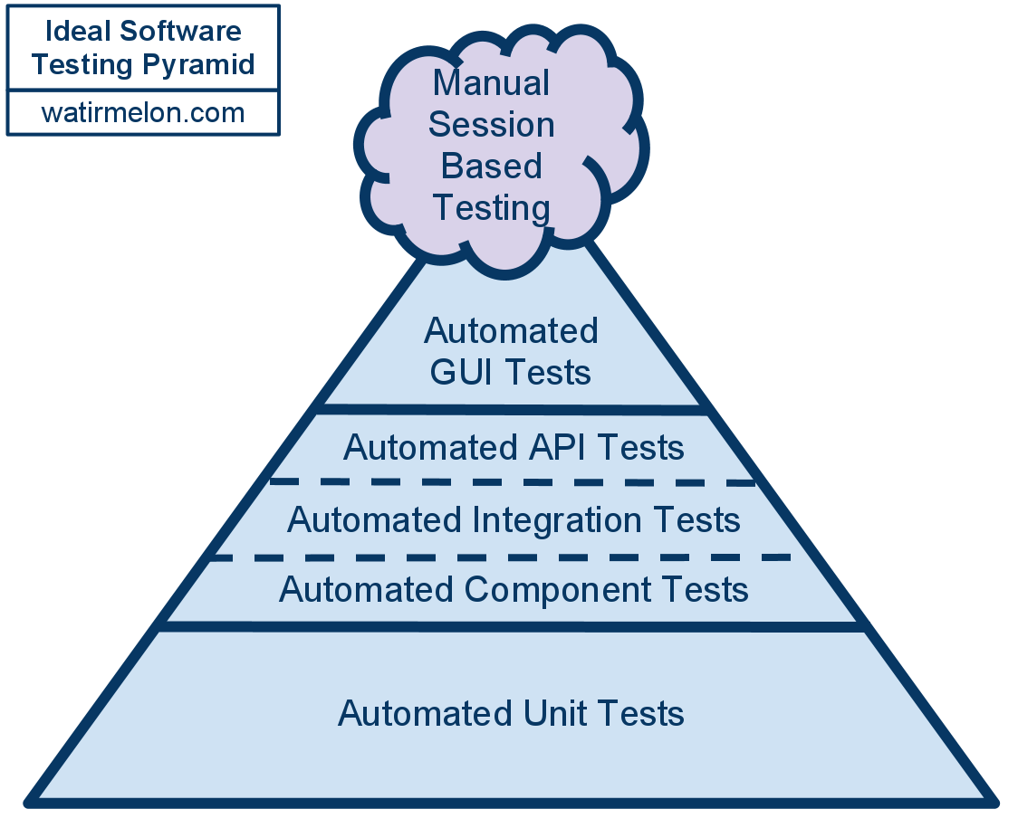
DevOps Testing Pattern

Slide 48
Continuous Integration
Continuous Integration is a practice where developers continuously commit code changes to a mainline branch.
Originated as part of Extreme Programming practices
Your software is broken until somebody proves it works.
Traditionally, developers would merge code changes once a day and do a nightly build.
Don’t break the build!
Developers would work on separate long-running code branches and face “merge hell”.
Benefit: deliver faster software changes with fewer bugs (which are caught earlier)

Slide 49

Continuous Integration Practices
Developers check-in code at least once a day
Code is built at every check-in
Code is unit tested at every check-in
Everyone can view the build and test reports (transparency)
Developers get fast feedback from build
Deliverables are stored in an artifact repository and deployed to a test environment after a successful build
Source: www.continuousdelivery.nu

Slide 50
DevOps Pipeline
DevOps pipeline is an automated process for getting software from version control into the hands of your users.
It’s automated Continuous Integration.
Key benefits to this pattern:
Effectively prevents the deployment of code that has not been thoroughly tested
Development and release process becomes rapid, repeatable, and reliable.
Releases become normal events and can occur much more frequently.
Source: Continuous Delivery, Humble & Farley

Slide 51
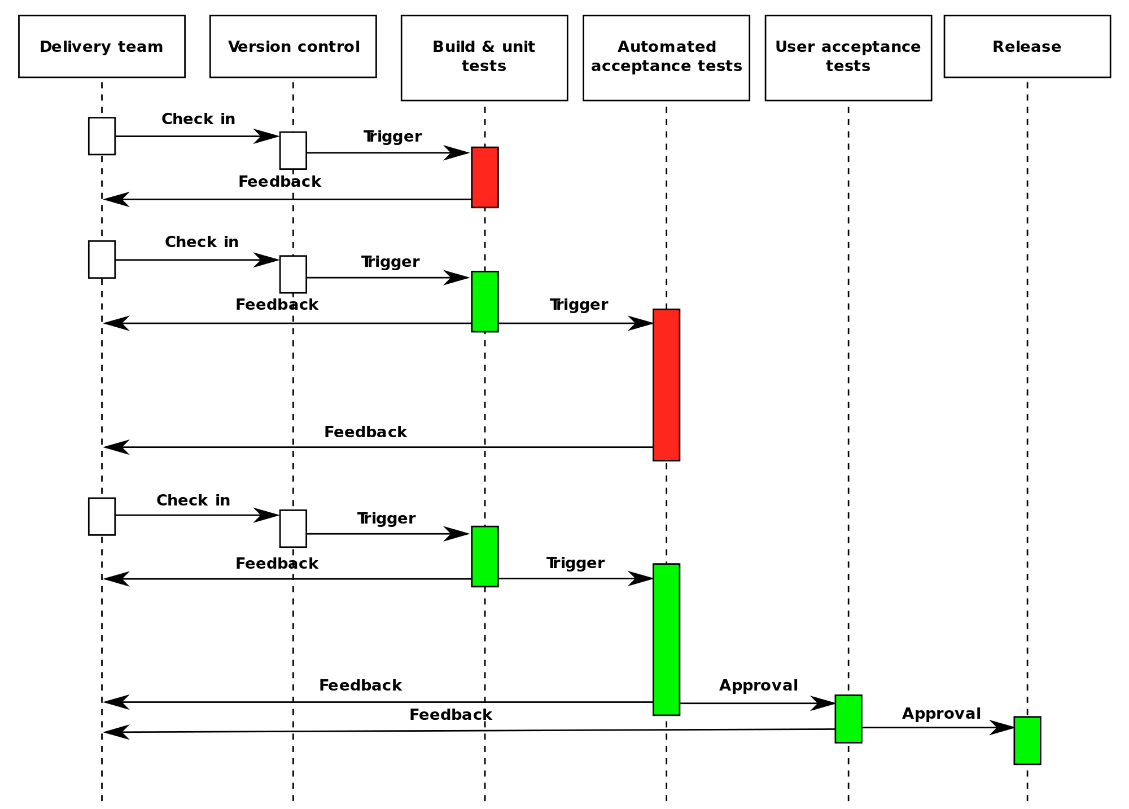

Slide 52
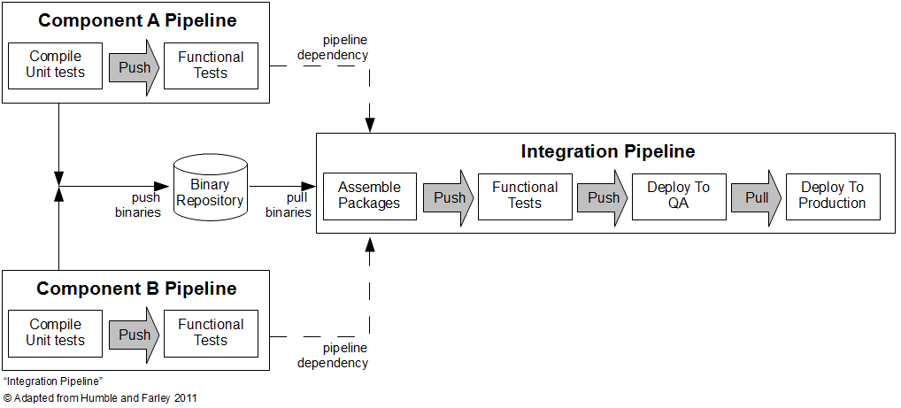

Slide 53
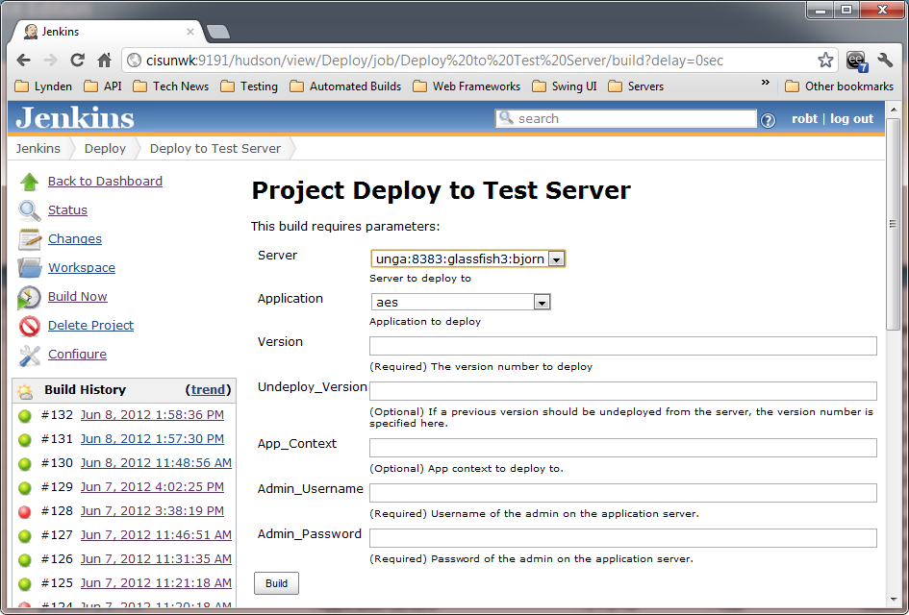

Slide 54
Deployment Pipeline Practices
Only build your binaries once.
Don’t keep re-compiling or packaging app at each stage to minimize introduction of configuration inconsistencies.
Store application artifacts in a repository (example: Artifactory)
Deploy the same way to every environment.
Use the same script to deploy to a dev laptop and a public cloud service
Store environment-specific configurations in separate files
If any part of the pipeline fails, stop the line.
If a deployment to an environment fails, the whole team owns that failure and every effort should be taken to fix it.

Slide 55
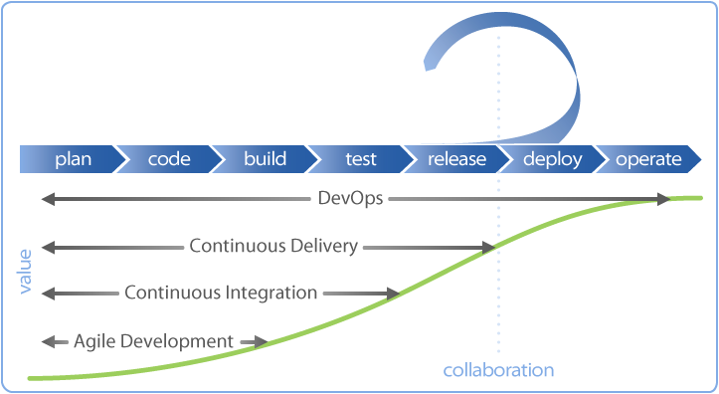
Continuous Delivery
Software is deployable throughout its lifecycle.
Team prioritizes keeping the software deployable over working on new features.
All parts of the pipeline are extensively automated including the deployment environment.

Slide 56
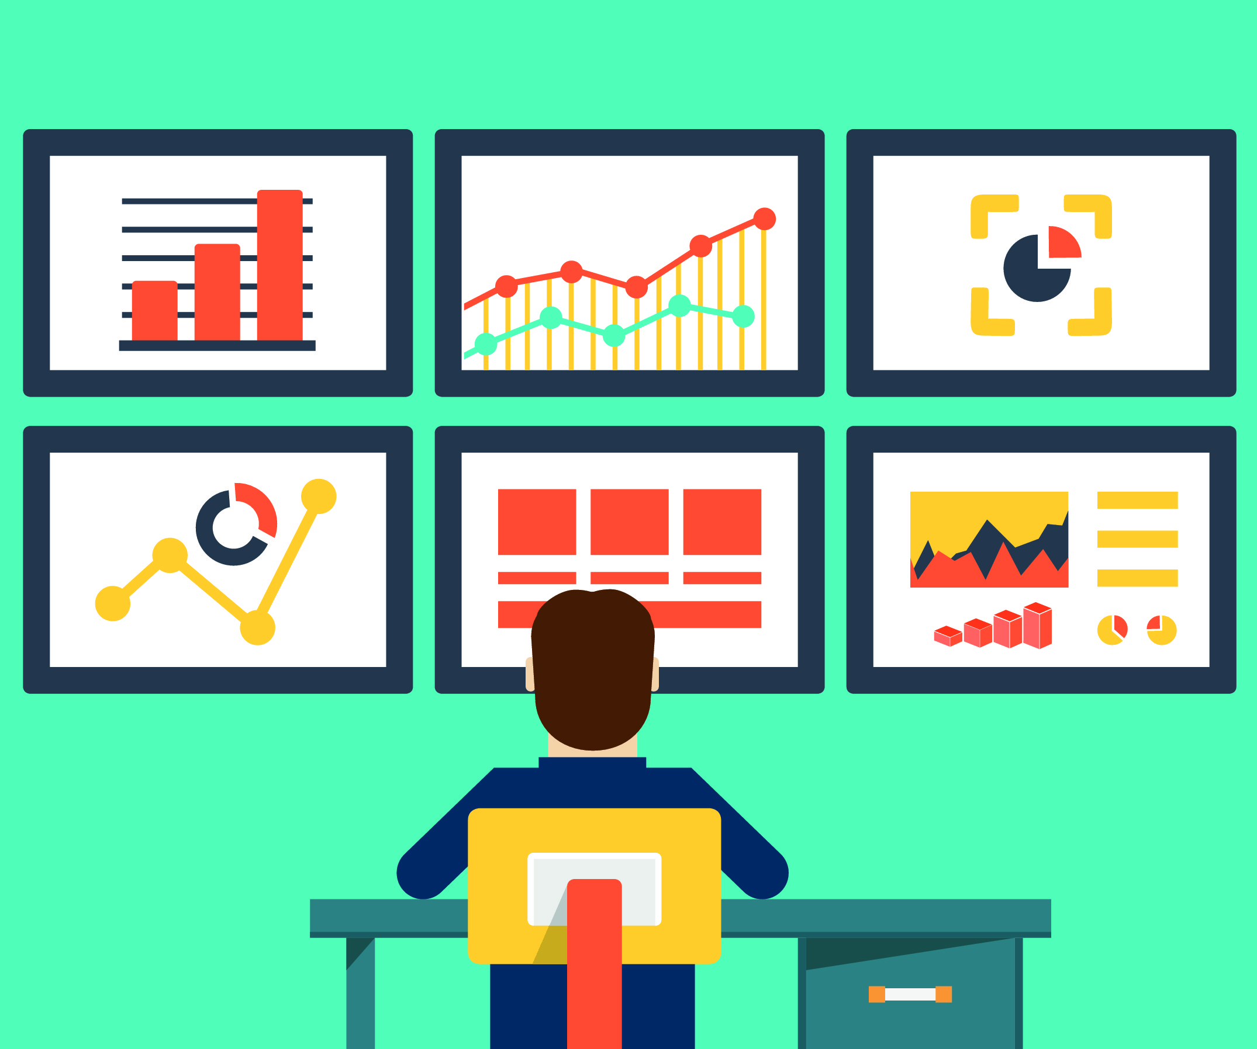
Metrics

Slide 57
Metrics
DevOps organizations ruthlessly collect data
You never know when you’ll need it.
Collect data from diverse resources and store in a central repository.
Time-series and unstructured data
Make it easy to search data to identify trends and correlations.

Slide 58
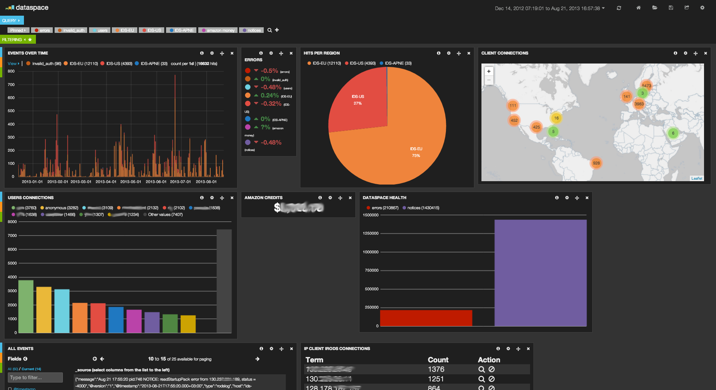
ELK Stack
Elasticsearch + Logstash + Kibana

Slide 59
KPIs
Identify Key Performance Indicators (KPIs) that measure service quality
Change error rate, Uptime, Response latency, Support calls, Revenue, etc.
Work to refine those metrics and iteratively improve
Generate notifications to alert staff on service health issues
Weed out non-actionable notifications (log but don’t email)
Example: failing infrastructure is not actionable if the service is self-healing
Caveat: If a service is self-healing at a greater than expected rate, that might be actionable.

Slide 60
Metrics & Decision-making
Metrics drive decision-making in high performing DevOps organizations
People perceive the world differently based on experiences and biases.
Oftentimes our technical solutions are educated guesses.
Let’s add more memory to see if the problem goes away.
Use metrics to support recommendations
Any recommendation not supported by data is considered a guess and is therefore risky.
Cloud infrastructure gives us a cheap way to run experiments.

Slide 61

Parting Notes
You cannot change your organization into a DevOps unicorn overnight.
Culture is the hard part, tooling is easy.
Set realistic goals and try to improve your processes every week.

Slide 62
Homework
Assignment X
Read How Cloud Has Changed the Data Center Architect
Read 6 Models Of The Modern Data Center

